Slide 1
Reduced Order Modeling of Turbulent Flows using LSTM and Bidirectional LSTM Neural Networks
Arvind Mohan
Datta Gaitonde
High Fidelity Computational Multi-Physics Lab
The Ohio State University, Columbus, OH,USA
2nd Workshop on Physics Informed Machine Learning
Center for Nonlinear Studies
Los Alamos National Laboratory
Santa Fe, NM

Slide 2
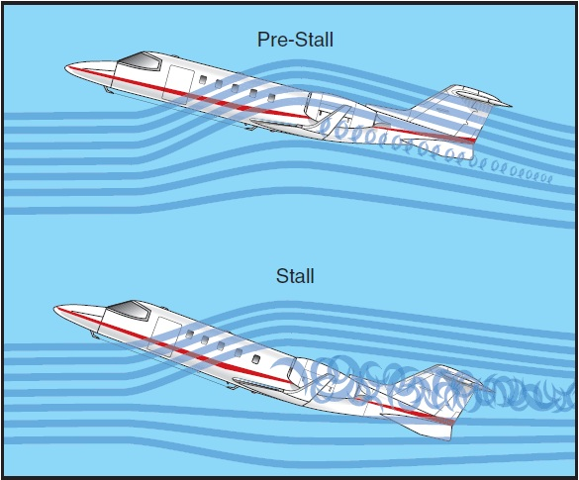
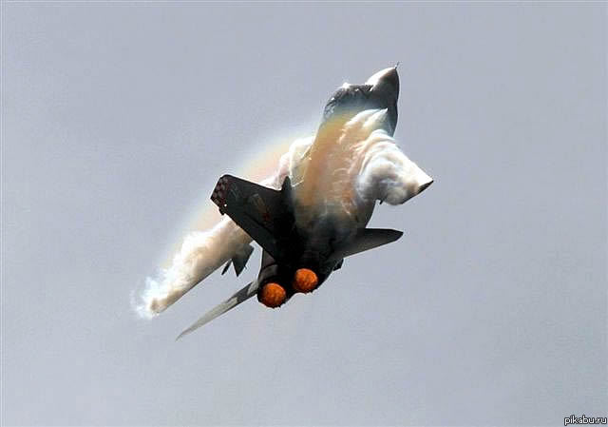
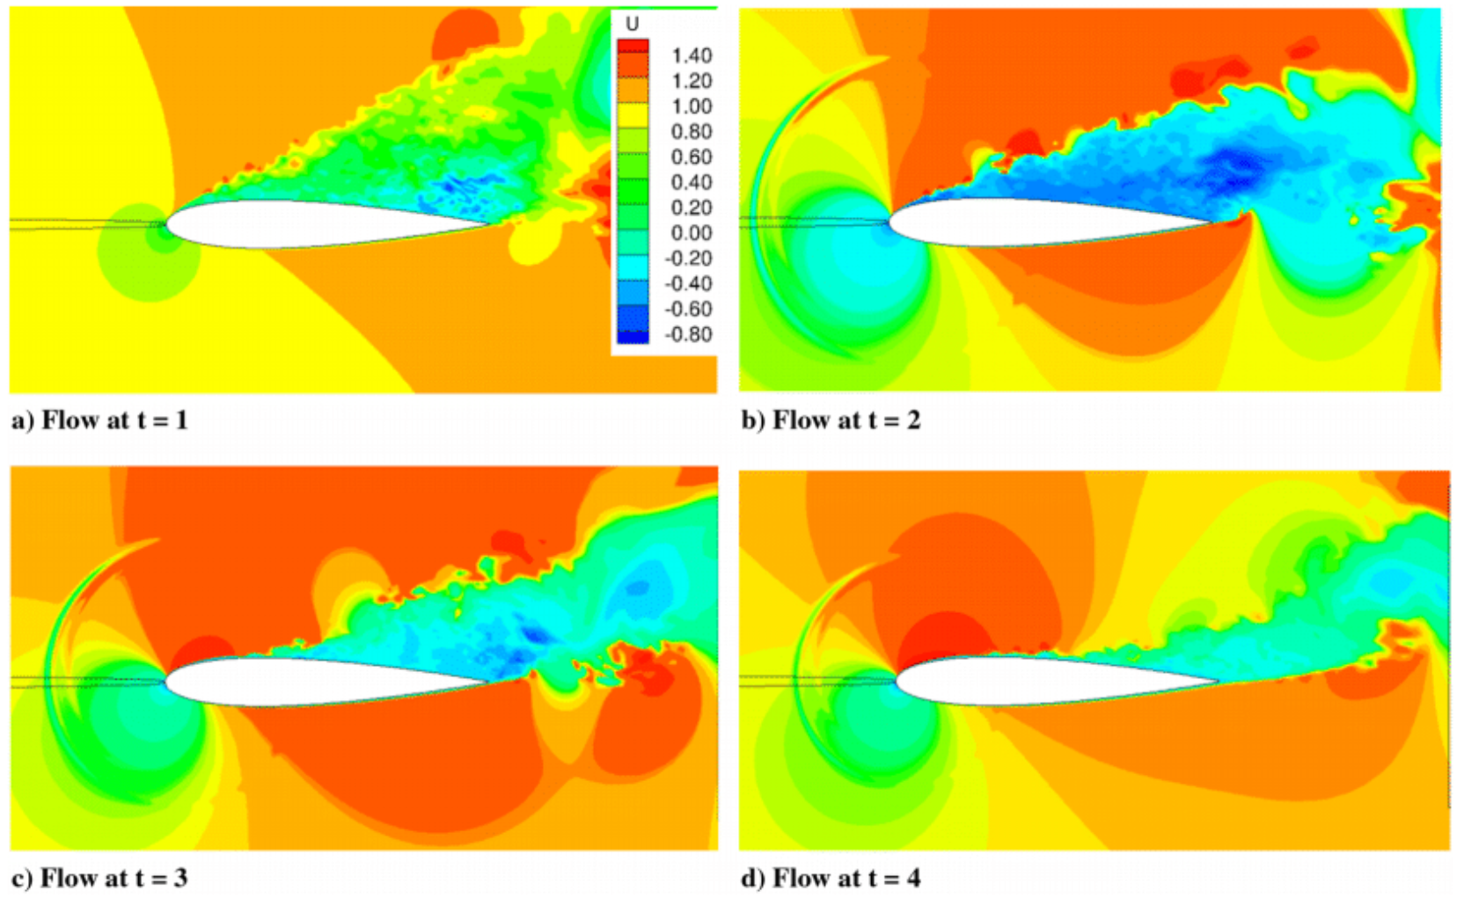
Turbulent Flow Control
Physics of Turbulent Flows in flight platforms dictate their safety and performance – Control of undesirable physics is a necessity
Example: Aircraft stall control
Actuator at the leading edge of the airfoil pulsing to prevent separation and reattach flow.
Actuator performance well studied in literature.
Key question: In real-time applications, “when” does the actuator go on-line?
Mohan & Gaitonde, 2017

Slide 3
Why Reduced Order Modeling?
Interdisciplinary problem at the intersection of dynamical systems, controls, predictive modeling and engineering design.
Embed the key physics/features of a flow-field in the control logic.
Complex flow-fields need to be modeled rapidly with very low cost, since computing power on on-board electronic hardware is limited
Full Navier-Stokes (NS) equations too expensive to compute + latency
Cost: LOW
Cost: HIGH
Physics model with ML embedding
Purely Data-driven Model
Basic ideas in building ROMs
1. Project high-dimensional dynamics of the NS equations to low-dimensional subspace → using model reduction.
2. Low dimensional dynamics evolved in time → ROM of flow-field.
CFD/Expt. Dataset
Modal Decomposition (e.g. POD)
Evolve modes in Time
ROM
Well studied problem in literature: Typical approaches include feedback control theory, Galerkin projection, linearization …but hard for complex flows

Slide 4
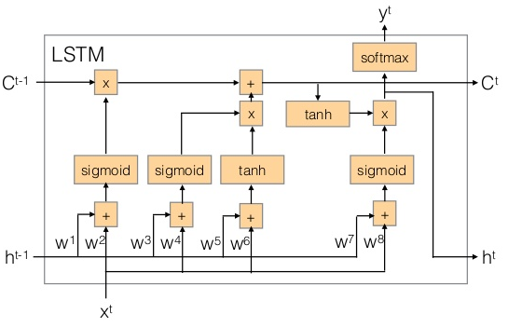
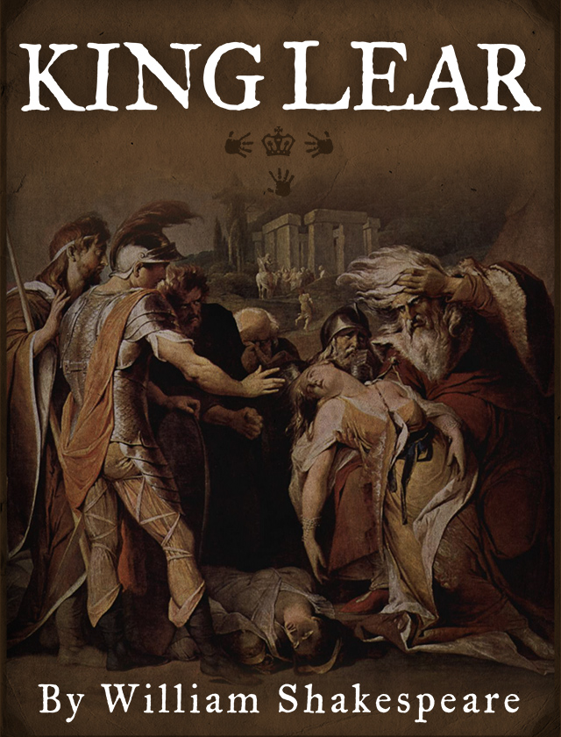

Long Short Term Memory Neural Networks
Long Short Term Memory (LSTM) is a specialized neural network which accounts for “memory” effects in sequential data, like time series (e.g. finance, physics, text).
State of the art in forecasting and pattern recognition for time series.
[1]
“O, if you were a feeble sight, the courtesy of your law,
Your sight and several breath, will wear the gods
With his heads, and my hands are wonder'd at the deeds,
So drop upon your lordship's head, and your opinion
Shall be against your honour.”
Can the pattern extraction and memory retention of LSTM be leveraged for turbulence ROMs?
LSTM extracts key patterns, trends in the training data and predicts future data which acquires these characteristics.
LSTM generated text
“I have no way and therefore want no eyes I stumbled when I saw. Full oft 'tis seen our means secure us, and our mere defects prove our commodities.”
Shakespeare’s Original Text Sample
Addresses backpropagation instability (Vanishing Gradient problem) found in traditional Recurrent Neural Networks → improved ability to propagate “memory” across time.
Long Short Term Memory (LSTM) consists of a series of cells, with internal memory states in each cell, along with a CEC (Constant Error Carousel) for propagating errors in backprop.
Internal states explicitly account for memory effects in the data by controlling information flow from past to the future.
[1] - http://karpathy.github.io
Notes:
2

Slide 5
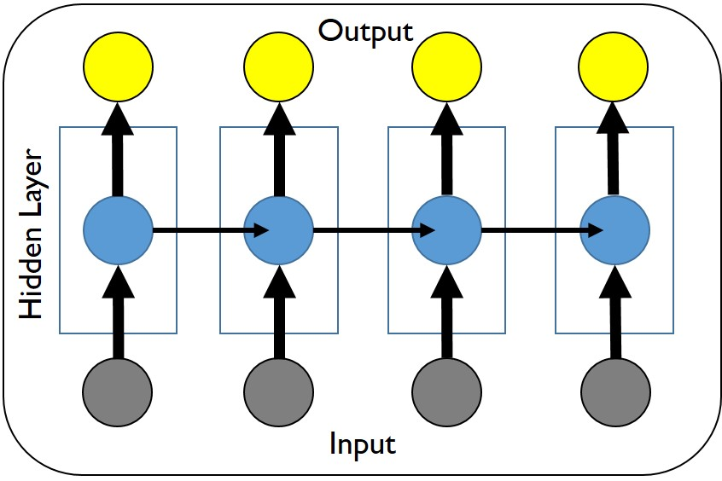
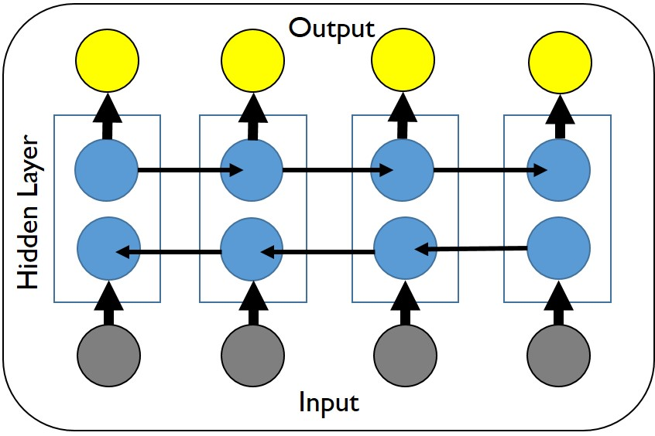
Long Short Term Memory Neural Networks
Vanilla (Traditional) LSTM
Input sequence used for training by hidden cells, to learn weights for a sequential output
Training Information travels in direction of sequence (forward).
Hochreiter & Schmidhuber, 1997
Bidirectional LSTM
Training Information travels in both forward and backward directions → “remembers” complex long term dependencies better.
Improved accuracy seen in literature, esp. for text modeling.
Graves & Schmidhuber, 2005
Can BiLSTMs increase prediction accuracy for problems like turbulence?

Slide 6
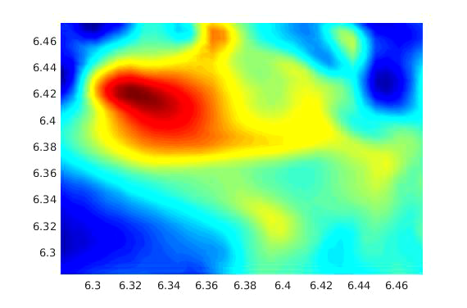
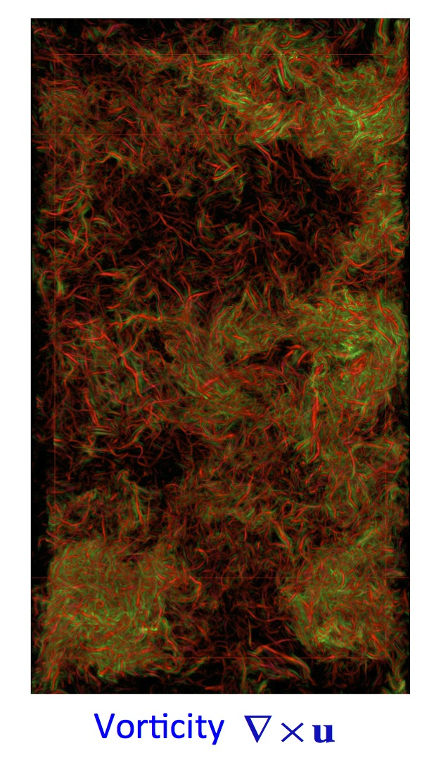
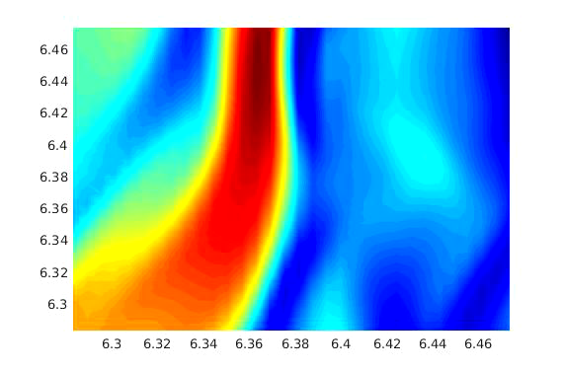
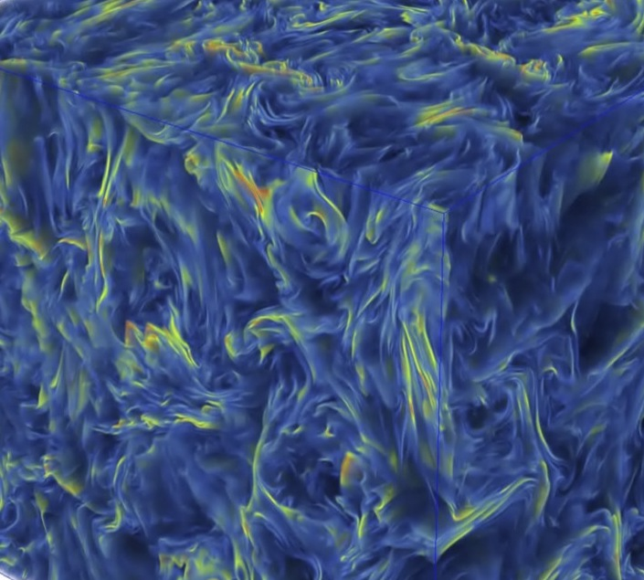
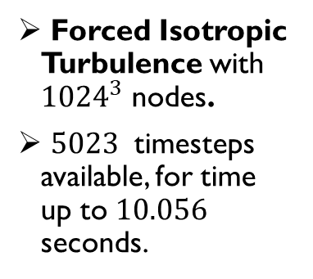
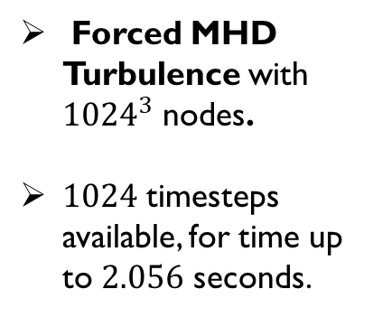
Datasets and Problem Setup
High Fidelity Direct Numerical Simulation (DNS) datasets from the Johns Hopkins Turbulence Database
Forced Isotropic Turbulence with ${1024}^{3}$ nodes.
${5023}^{ }$ timesteps available, for time up to $10.056$ seconds.
2D slices
Forced MHD Turbulence with ${1024}^{3}$ nodes.
$1024$ timesteps available, for time up to $2.056$ seconds.
2D slices
Long time history ➔ Suitable for training LSTM networks.
Utilized to study performance of LSTMs on 3D, highly turbulent flows – get
“worst case” baseline

Slide 7
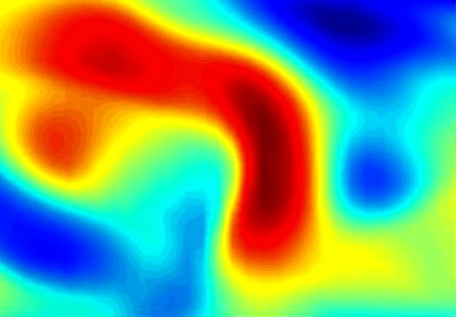
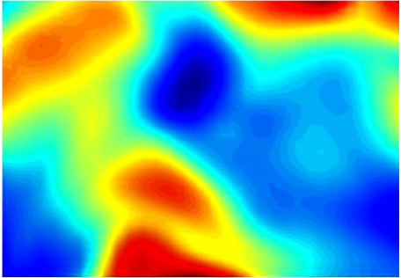

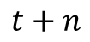
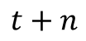
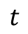
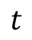

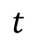
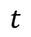
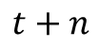
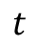

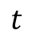
LSTM-ROM Methodology
Transient flow
$$t$$
Mode 1
→
1. Choose Datasets from closely related regimes
1. Choose Datasets from closely related regimes
Mode 2
$$t$$
→
POD
$$t$$
Mode 5
→
2. “Learn” temporal dynamics of (dominant) POD modes
2. “Learn” temporal dynamics of (dominant) POD modes
Training data
TRAINING
LSTM/BiLSTM Neural Network
PREDICTION
Test data
?
Mode 1
-------
3. Predict temporal behavior of test data POD modes, given previous time history
$$t$$
$$t+n$$
?
POD
Mode 2
-------
$$t$$
$$t+n$$
Mode 5
?
-------
$$t$$
$$t+n$$
Notes:
3

Slide 8
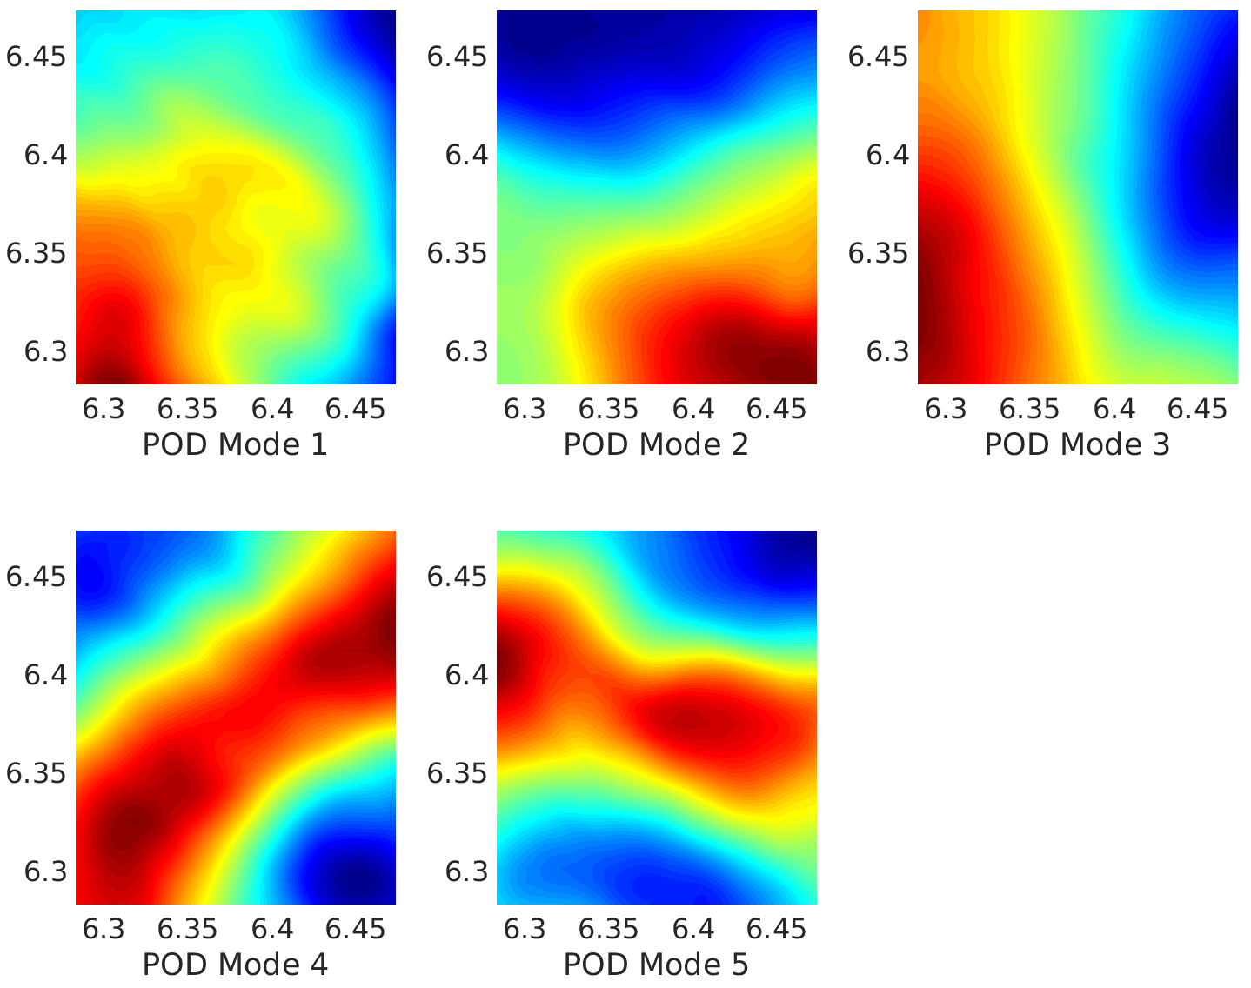
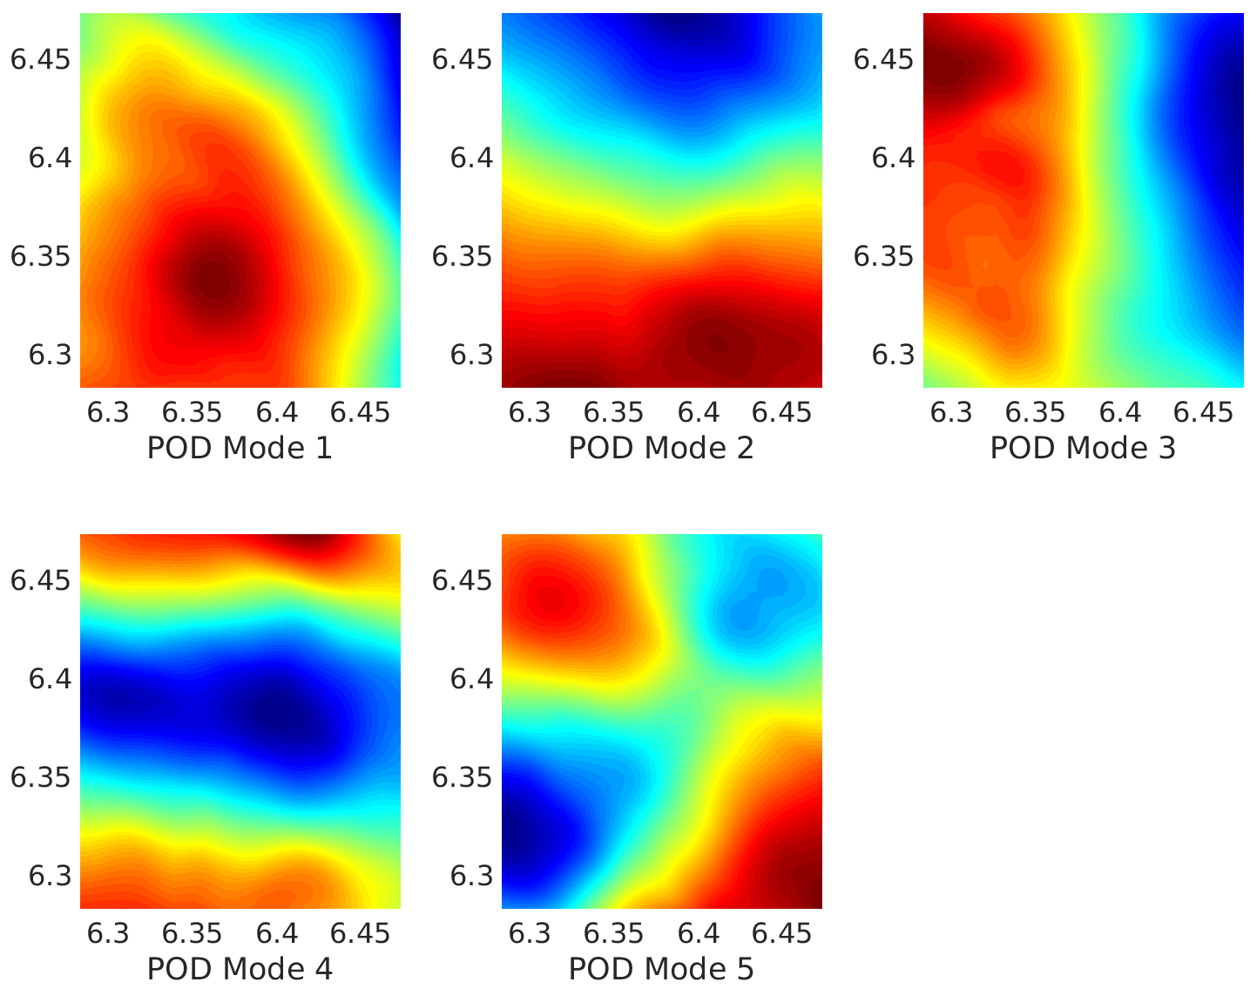
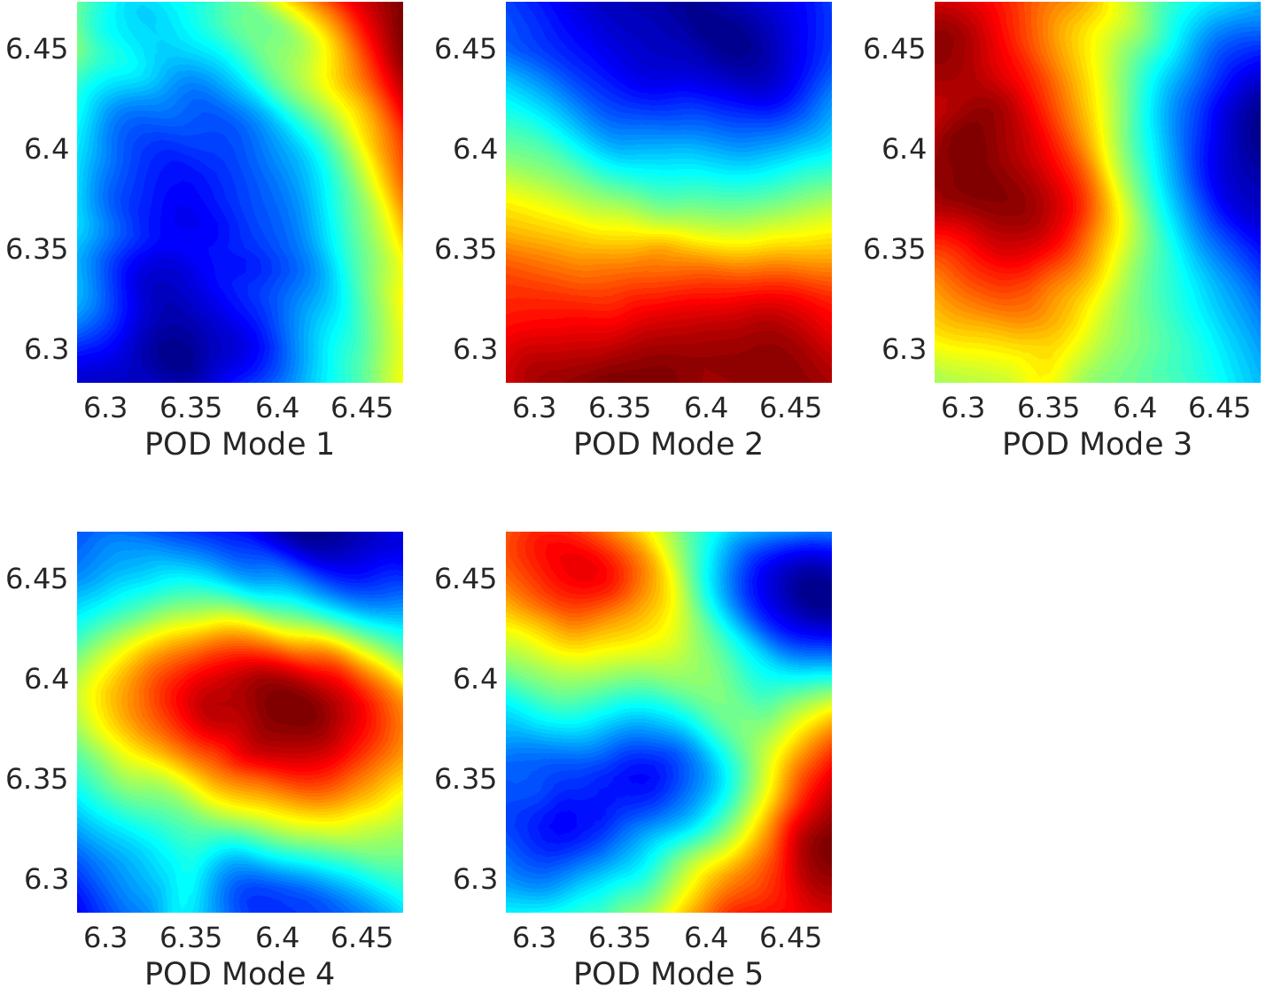
POD modes of Training and Test Data
Forced Isotropic Turbulence
Training Data 1
Training Data 2
Training datasets comprising of U-velocity at different planes
Qualitative Similarities between different datasets – part of the same flow system
Non-trivial differences exist
LSTM NN has to learn common features despite differences.
Test Data
Notes:
4

Slide 9



Training Strategy
How do we train a LSTM/BiLSTM for a regression problem?
Time →
Divide time series into numerous input/output pairs
Moving window through signal generates hundreds/thousands of such pairs → Training data.
Length of window, input and output sequence, is user defined
Train LSTM with the input-output pairs to learn the relationship between them
Use the trained model to make predictions for future time.
Input
Output
Training
LSTM/BiLSTM Network
Trained Model
LSTM/BiLSTM Network
Unseen Data Prediction
Goal: LSTM ROM using 5 Dominant POD modes
Notes:
5.5

Slide 10
Training Strategy
Objective: Predict POD temporal coefficients for t → t + n,
given 0 → t, and trained model from POD coefficients in OTHER datasets
Network Architecture and Training Details
Input layer of 10 cells ( i.e. size of input sequence )
1 hidden layer of 250 cells each
Output layer of 10 cells (i.e. size of output sequence )
Hyperparameter tuning performed with random search
Batch size = 32, trained for 75 epochs.
Training Strategy # 1: Temporal coefficients of each of the 5 dominant POD modes from all training dataset planes.
Models: 5 LSTM/BiLSTM models, for each dominant mode.
Network depth and number of cells same for
Both Vanilla LSTM and Bidirectional LSTM for comparison
Same network architecture used for all 5 POD modes – Reduced Hyperparameter tuning cost.

Slide 11
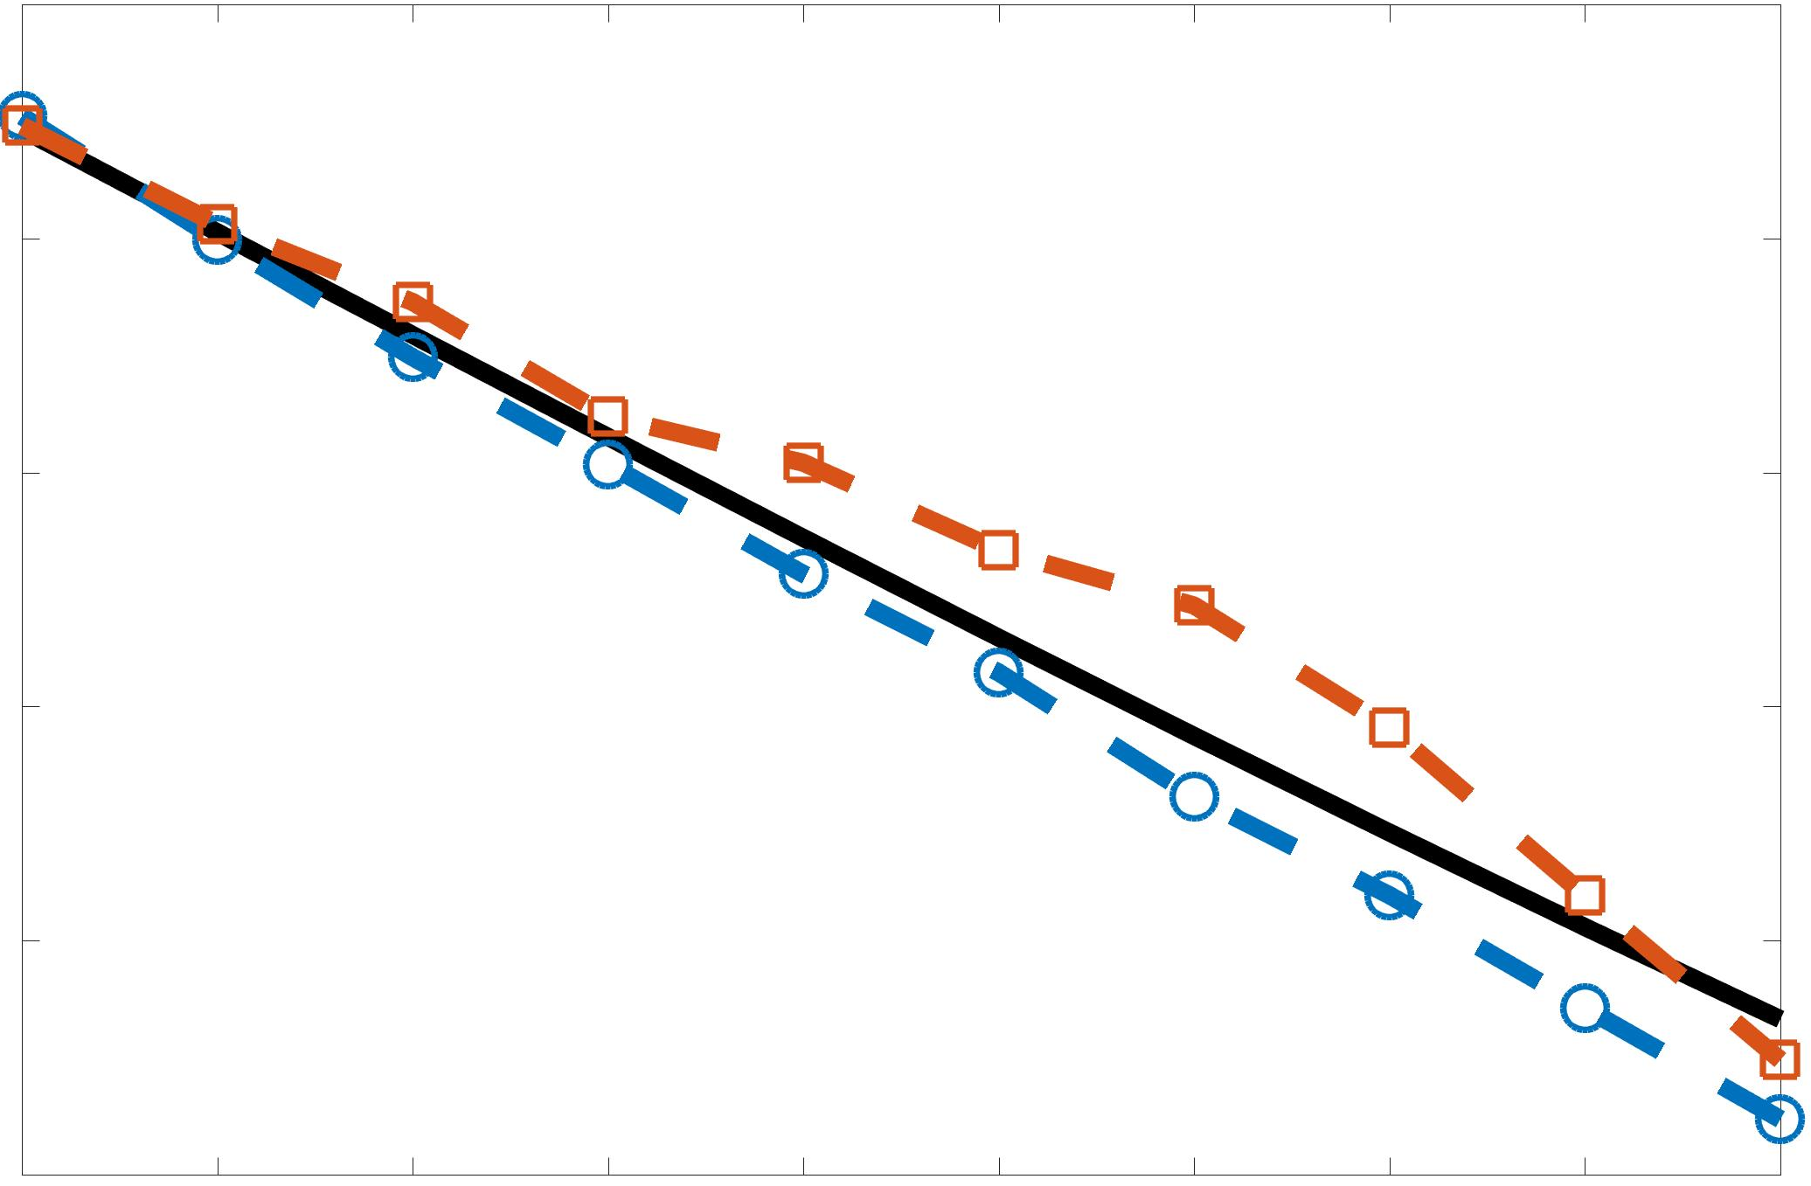
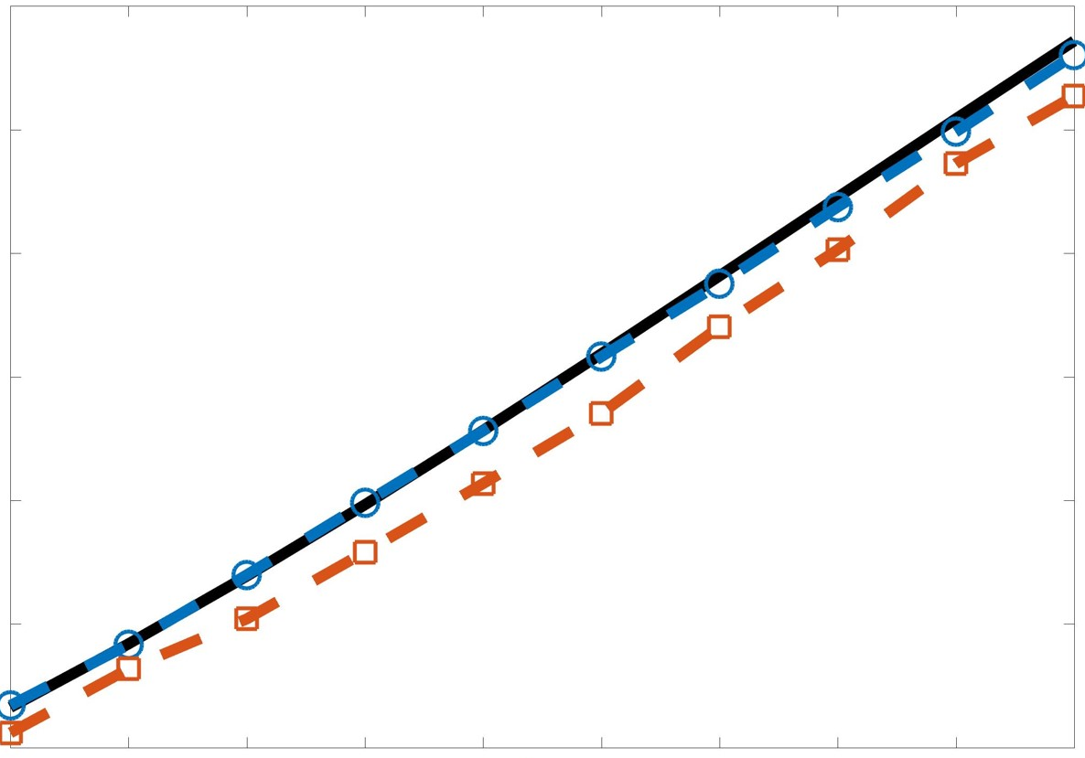
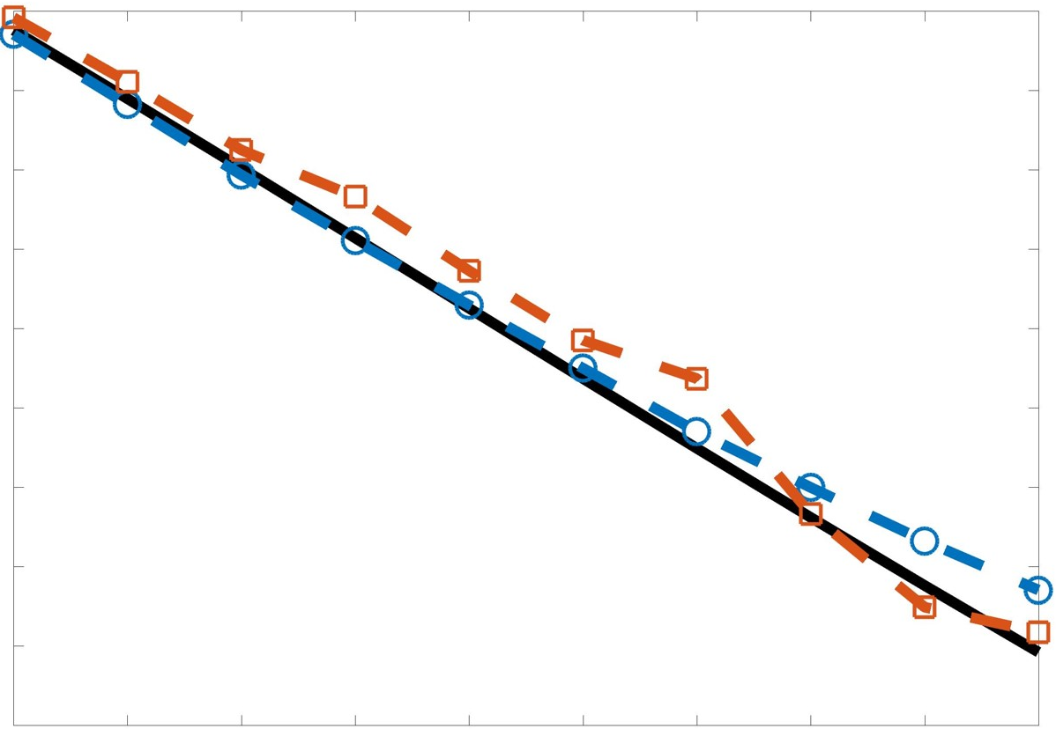
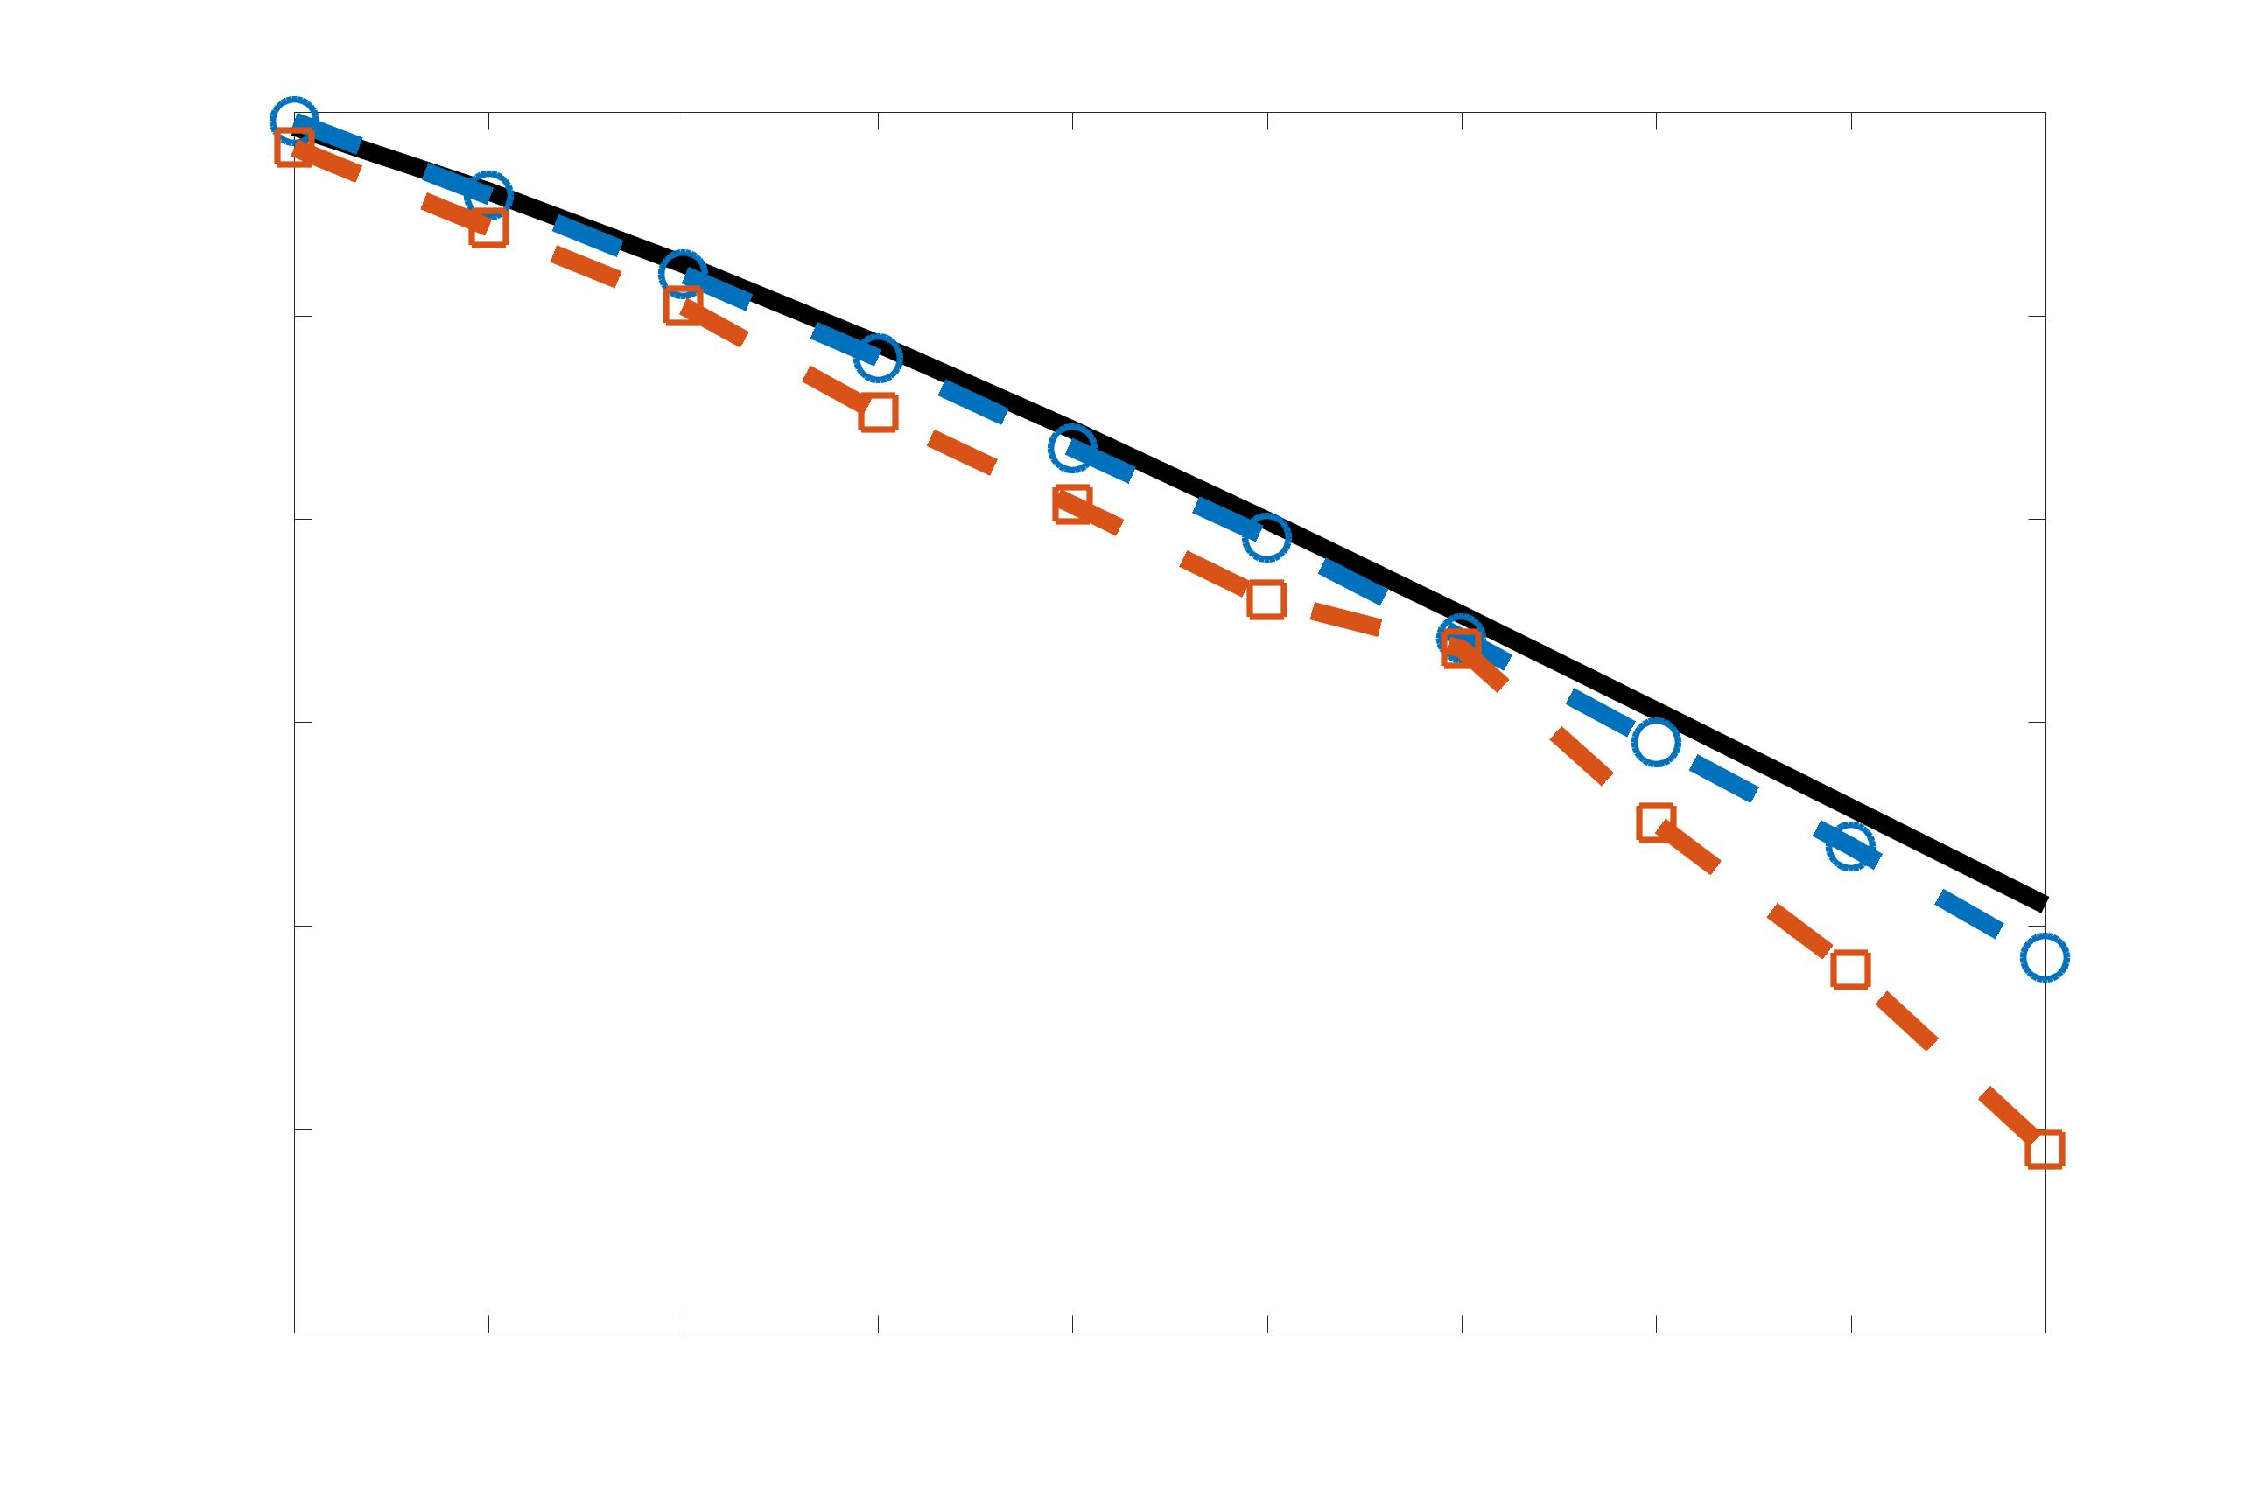
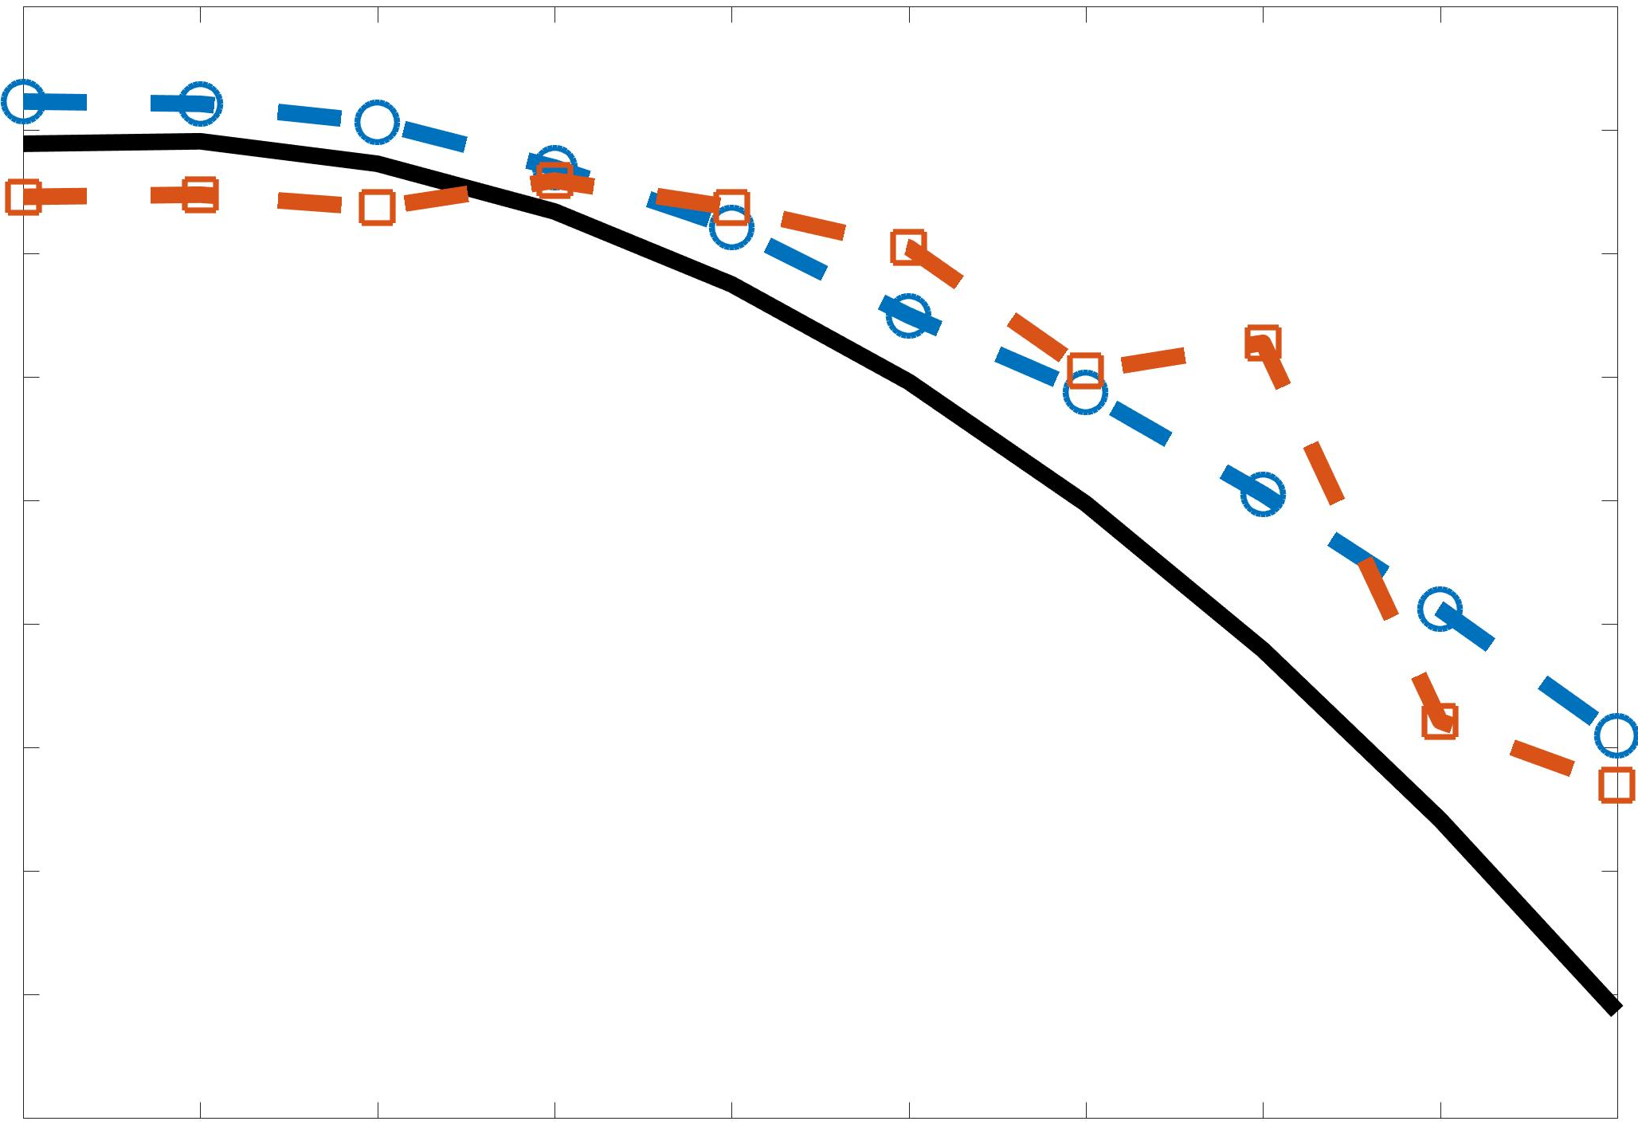
LSTM & BiLSTM POD Coefficient Predictions
Forced Isotropic Turbulence
Amplitude
Mode 1
Mode 2
Mode 3
Time
Time
Time
Amplitude
BiLSTM
LSTM
Truth
Mode 4
Mode 5
Time
Time
Predictions shown below for a randomly chosen time instants in the flow.
BiLSTM underperforms, contrary to its performance in literature – not the algorithm’s fault !
Lack of very long range memory in chaotic dynamical systems a likely reason.

Slide 12
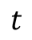
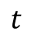

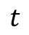
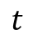

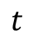
Training Strategy
Alternative approach to training: Do we really need a unique model for each dominant mode? (More resources….)
Training Strategy # 2: Temporal coefficients of each of ALL 5 dominant POD modes from all training dataset planes.
Transient flow
$$t$$
Mode 1
→
Mode 2
$$t$$
→
Learn temporal dynamics and features universal to the dominant POD modes
POD
Training
$$t$$
Mode 3
→
Mode 4
$$t$$
→
Training data
Mode 5
$$t$$
→
1 LSTM/BiLSTM model for ALL dominant modes Far more efficient and low memory for inference on control hardware
But how does it perform?

Slide 13
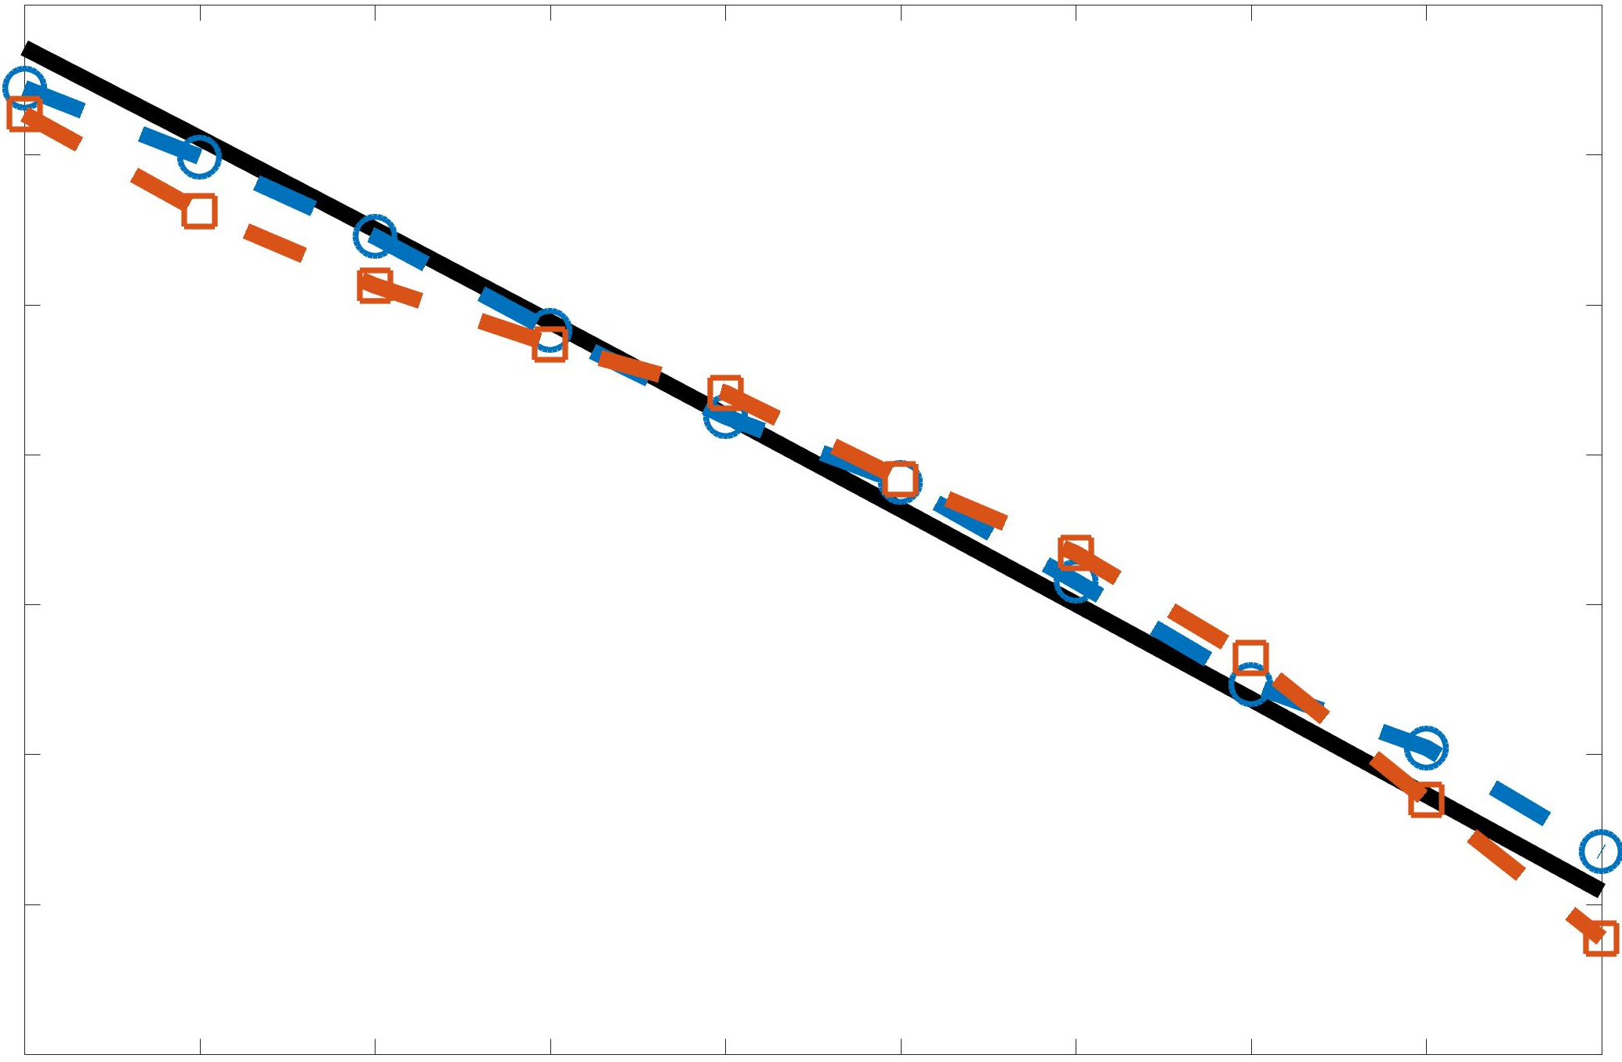
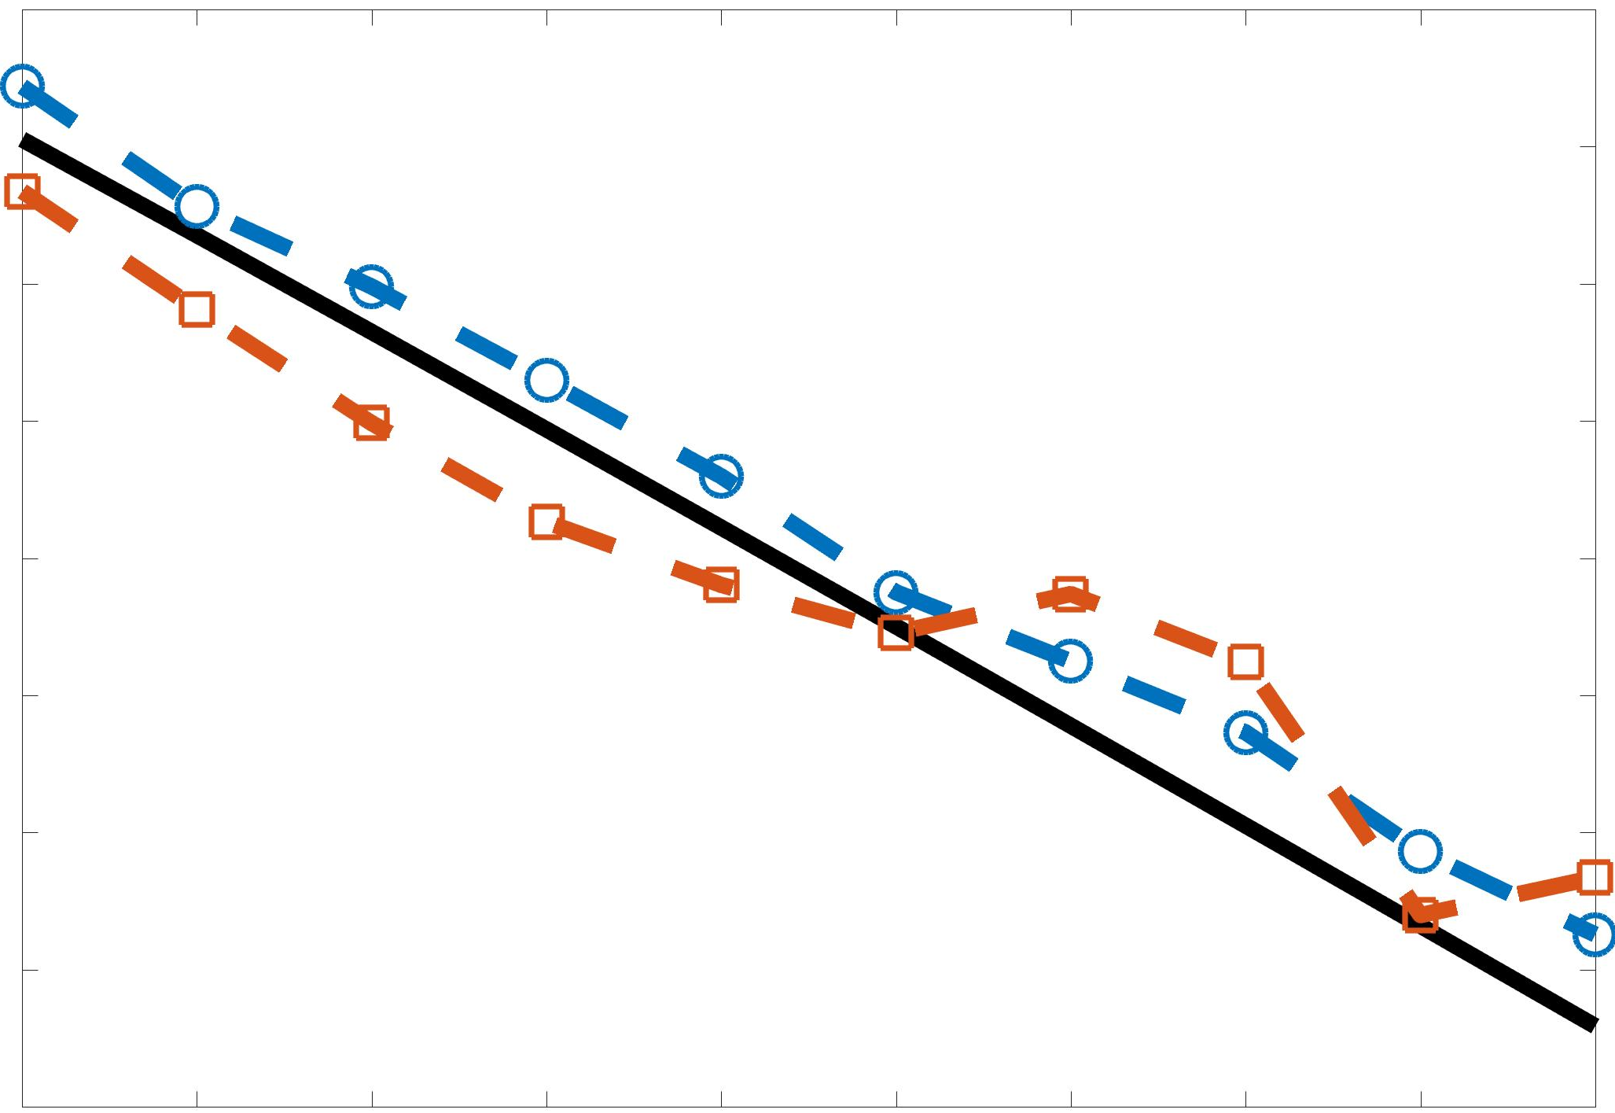
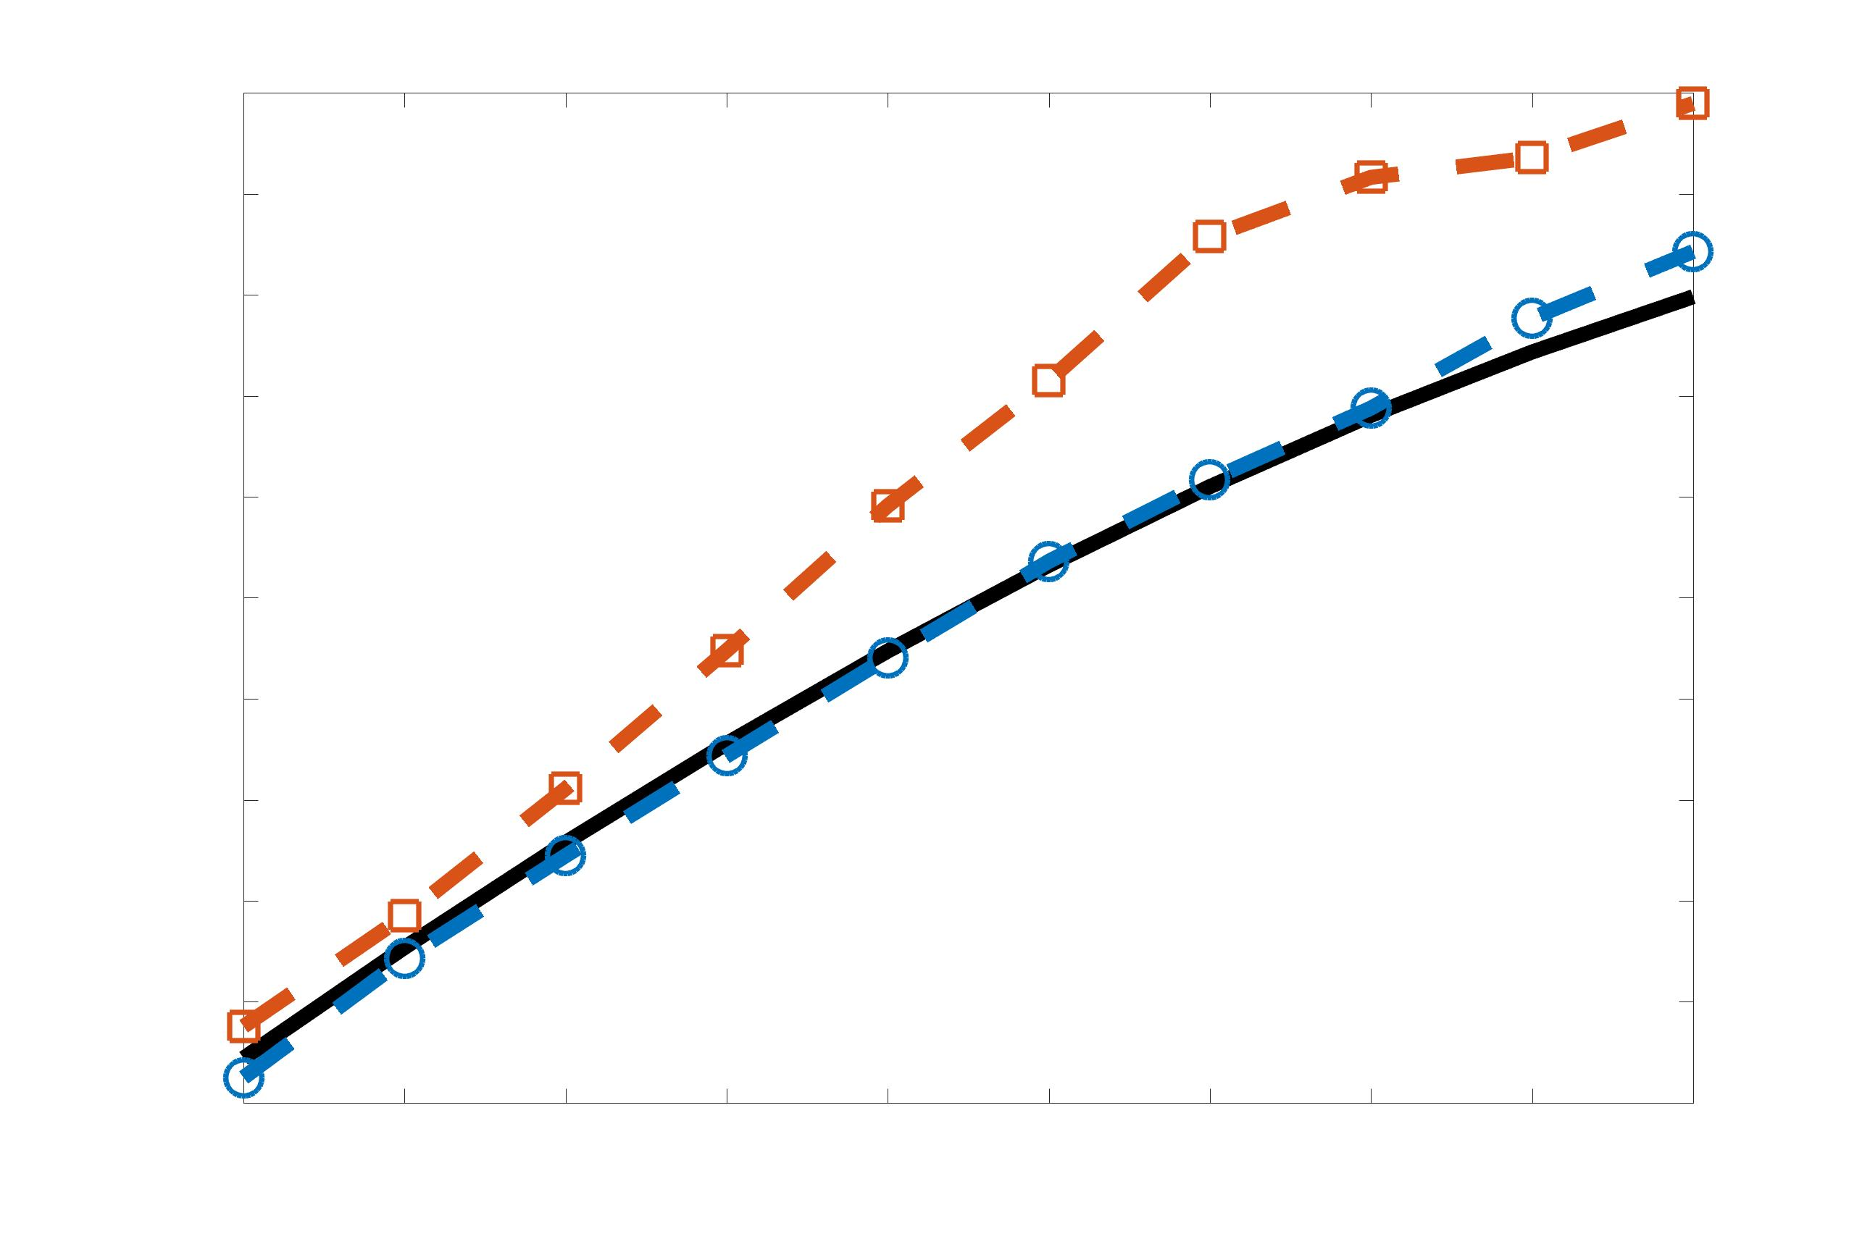
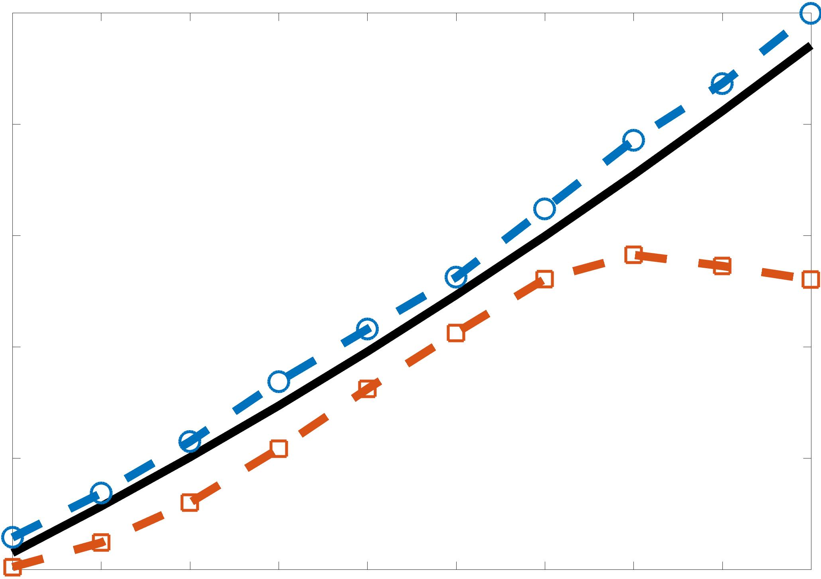
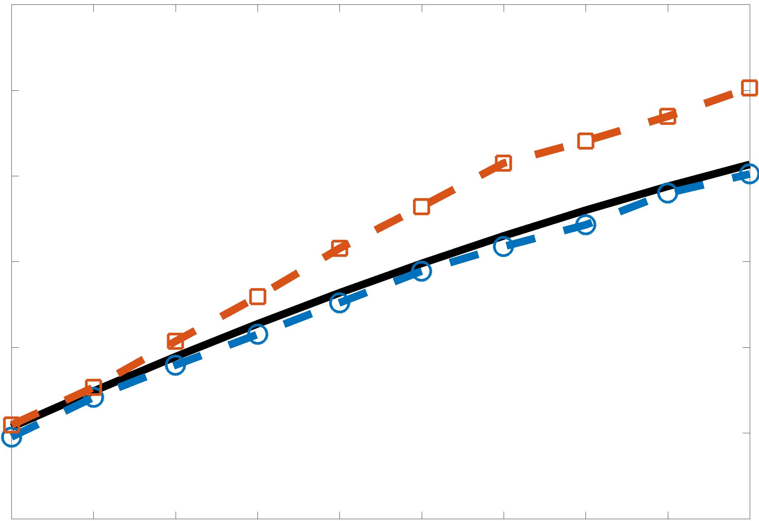
LSTM & BiLSTM POD Coefficient Predictions
Forced MHD Turbulence
Amplitude
Mode 1
Mode 2
Mode 3
Time
Time
Time
Amplitude
BiLSTM
LSTM
Truth
Mode 4
Mode 5
Time
Time
Predictions shown below for a randomly chosen time instant in the flow.
BiLSTM underperforms –similar to Isotropic Turbulence case.
Single model approach performs on par with dedicated models for every mode.

Slide 14
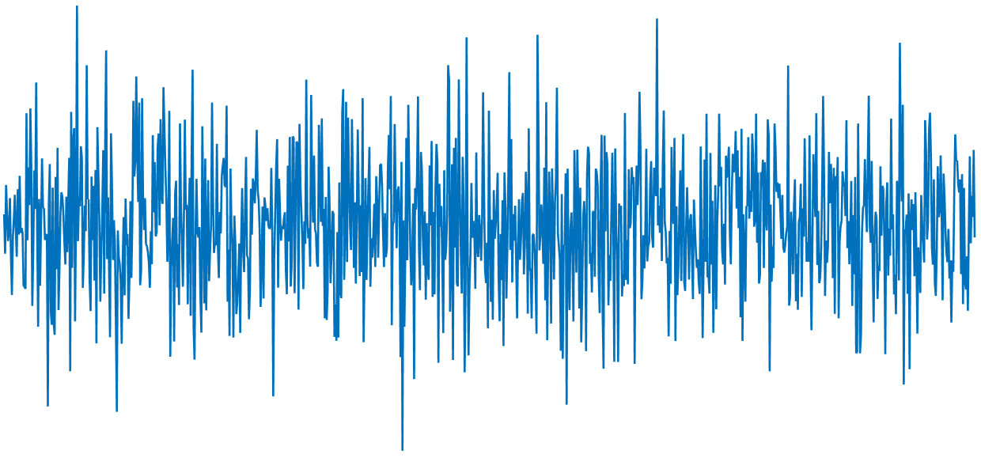

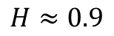
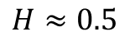
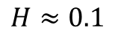
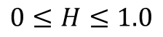
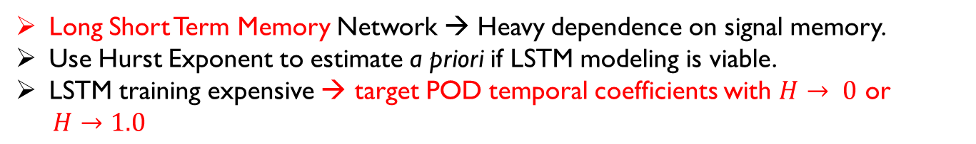
Memory in Signals and Impact on Prediction
Can we quantify memory in a sequential dataset?
Hurst Exponent (H)
Measure of long-range memory dependence in signal
Long-term storage capacity of reservoirs, E . Hurst, 1951
Existence of hidden long term trends in a signal
Long term switching to higher or lower values
Noah, Joseph, and operational hydrology, B. Mandelbrot and J.R Wallis, 1968
The (Mis)behavior of Markets: A Fractal View of Financial Turbulence, B. Mandelbrot and R. Hudson, 2004
Measure of extent of randomness in signal: Ranging from “mild” to “wild”
$$0≤H≤1.0$$
Anti-persistent
Random
Persistent
$$H≈0.1$$
$$H≈0.5$$
$$H≈0.9$$
Signals closer to $H≈0.5$are more random → harder to predict
Applications:
Long Range Correlations in DNA: Scaling Properties and Charge Transfer Efficiency, Roche et. al., 2003
Climate change, the Hurst phenomenon, and hydrological statistics, Koutsoyiannis, 2002
Time-varying Hurst exponent for US stock markets, Alvarez-Ramirez et. al., 2008
Long Short Term Memory Network → Heavy dependence on signal memory.
Use Hurst Exponent to estimate a priori if LSTM modeling is viable.
LSTM training expensive → target POD temporal coefficients with $H→ 0$ or
$H→1.0$
Notes:
8.5

Slide 15
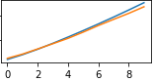
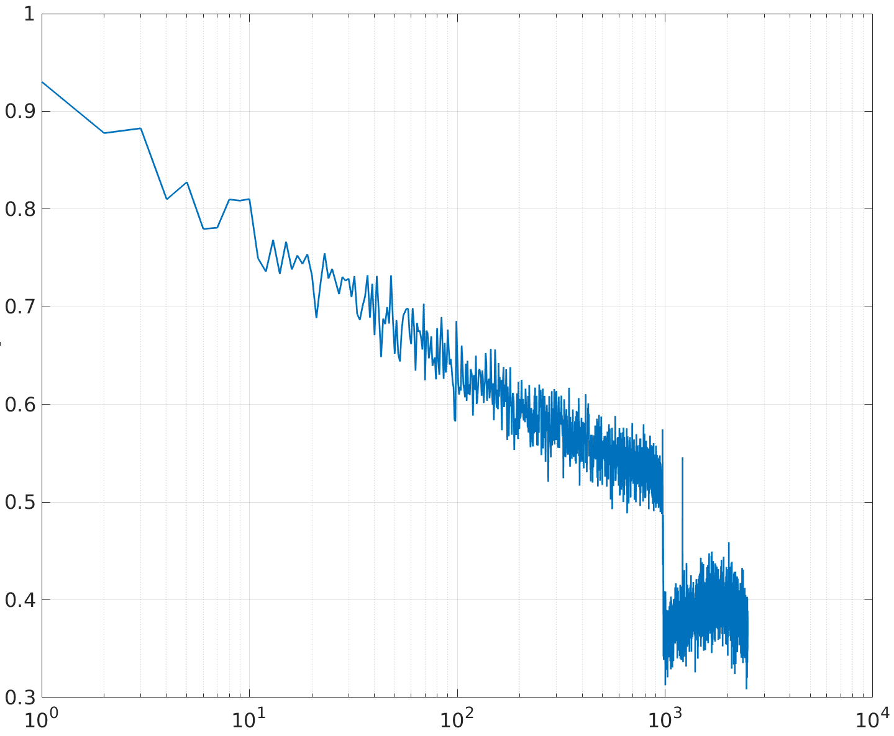







Memory in POD Mode Coefficients
Estimate $H$ for all POD mode temporal coefficients
Train POD mode coefficients with varying $H$ to determine effect of memory on LSTM prediction accuracy
SAME LSTM architecture used for all POD modes → Significant reduction in ROM training cost
Lower POD modes with $H →0.5$, harder to predict.
Higher POD modes have $H →1.0$, easier to predict.
Higher POD modes have flow structures with significant long term memory → Ideal candidate for LSTMs.
Can use $H$ to determine number of modes to build ROM for a given LSTM model.
POD mode 7
Amplitude
Mode 7
Mode 15
POD mode 15
Hurst Exponent (H)
Mode 50
Mode 100
Amplitude
Mode 400
POD mode 50
Modes →
Amplitude
Possible Treatment:
$H →0.5$modes may benefit from a dedicated LSTM/Statistical model, though very limited success for $H≈0.5$. But increases cost.
$H →0.5$signals may benefit from filtering/de-noising strategies to uncover hidden long term behavior i.e. Make $H →0$ or $H →1.0$
POD mode 100
Mode 7
Mode 15
Amplitude
Mean Prediction Accuracy
Mode 50
Mode 100
Mode 400
POD mode 400
Amplitude
Time Instants
Notes:
9.5

Slide 16
Conclusion & Future Directions
LSTM based ROM methodology proposed for turbulent flow control algorithms.
Bidirectional LSTM may not increase performance on highly turbulent flows due to lack of very long range correlations/dependencies/memory in the signals.
Hurst Exponent may be used as an “indicator of predictability” for predictive modeling, especially LSTM networks.
Future Directions:
Increase prediction horizon and improve accuracy with a) Better data augmentation/pre-processing, b) Improved NN architectures, for a variety of flow-fields.
Fundamental limitations on purely data-driven forecasting of a chaotic time series.
High Priority: Embed LSTMs in physics-based governing equation models for Turbulence modeling/dynamical systems modeling

Slide 17

Thank You!
Acknowledgements:
Air Force Research Laboratory Collaborative Center for Aeronautical Sciences
Ohio Supercomputer Center
Air Force Office of Scientific Research

Slide 18






LSTM-ROM of Flow-field
Actual Data
LSTM-ROM Prediction
t = 8.10 – 8.15
t = 8.16 - 8.21
Spatial Error between LSTM-ROM and actual reconstruction O(${10}^{−3}$)

